Slide 1
Group - 3
6G Wireless Networks
Akash Varunn D - CB.SC.U4CYS23001
Dinesh V Masuti - CB.SC.U4CYS23012
Martin Rozariyo - CB.SC.U4CYS23025
Praneesh R V - CB.SC.U4CYS23036

Slide 2
01
6g Wireless Communication Networks: A Comprehensive Survey
Based on M. Alsabah et al., IEEE Access, Vol. 9, 2021
Notes:
"Good morning/afternoon. The paper I'm presenting today, 'A Comprehensive Survey on 6G Wireless Communications Networks,' provides a detailed roadmap for the next wireless frontier. It argues that while 5G is still being rolled out, the exponential growth in data demand is already pushing us to envision what comes next."

Slide 3
The Coming Data Tsunami:
Why 5G Won't Be Enough
We are on the verge of a data explosion that will overwhelm current networks.
Massive Growth: Mobile data is projected to hit 5016 Exabytes/month by 2030.
Key Drivers:
Explosion of IoE and smart devices.
New ultra-reliable, low-latency (URLLC) applications.
The Bottleneck: 5G capacity cannot sustain this growth, driving the need for 6G.
Notes:
"So, why do we even need 6G? The numbers are staggering. This paper highlights projections that by 2030, global mobile data traffic will reach over 5,000 Exabytes every single month. This isn't just more people streaming videos. It’s driven by the Internet of Everything—billions of smart devices, sensors, and autonomous systems all communicating simultaneously. These applications don't just need speed; they demand extreme reliability and almost zero delay. The conclusion is clear: 5G, as powerful as it is, simply won't be able to keep up. This is the fundamental motivation for developing 6G."

Slide 4
Maximizing Data Rate -
The Road to Terabits/sec
Speed Boost: Utilizing mmWave & THz (0.1-10 THz) for huge bandwidth.
Smart Environment:
RIS: Intelligent surfaces reflect/steer signals, improving coverage.
Holographic MIMO: Dense antennas create focused beams, reducing loss.
Notes:
"The first pillar of 6G is a monumental leap in data rates—moving from gigabits to terabits per second. The paper outlines several key technologies to achieve this. A primary strategy is moving to new, ultra-high frequency bands like millimeter-wave and, beyond that, Terahertz (or THz) spectrum, which offers enormous bandwidth. But perhaps the most revolutionary idea is the concept of Reconfigurable Intelligent Surfaces, or RIS. Imagine coating a wall with a special material that can be programmed to intelligently reflect and focus radio signals exactly where they're needed, essentially turning a passive environment into an active part of the network. This is complemented by Holographic MIMO, which uses a dense array of antennas to create incredibly precise, narrow beams that cut through interference and boost signal strength."

Slide 5

Total Connectivity -
Connecting Everything,Everywhere
Integrated Network: 6G combines space (satellites), air (drones/HAPS), and ground (towers) networks into one seamless system. This eliminates coverage gaps in remote areas like deserts and oceans.
Cell-Free MIMO: Instead of connecting to a single tower, you'll be served by many access points at once. This gets rid of cell boundaries and provides a consistently strong, high-quality signal everywhere.
Notes:
"The second pillar is achieving truly total and ubiquitous connectivity. 6G aims to eliminate the concept of a 'dead zone.' This will be accomplished through a unified, three-dimensional network that integrates traditional ground-based stations with non-terrestrial platforms. We're talking about a seamless network combining low-earth orbit satellites, high-altitude balloons, and drones, all working in concert to provide coverage over oceans, deserts, and in disaster-stricken areas. Hand-in-hand with this is a new network design called Cell-Free Massive MIMO. Forget handing off from one cell tower to the next. In a cell-free system, you are constantly and simultaneously served by all the access points around you, creating a seamless, robust, and uniformly high-quality connection no matter where you are."

Slide 6
The "Ultra Era" -
New Applications & Realities
Holographic Telepresence: Immersive, multi-sensory 3D communication requiring extreme data rates (>4 Tbps).
Tactile Internet: Real-time remote control with haptic (touch) feedback for applications like remote surgery and industrial robotics
.
Multi-Sensory XR: A full convergence of AR/VR/MR, creating virtual worlds indistinguishable from reality.
Notes:
"With this incredible speed and connectivity, what will we be able to do? This brings us to the third pillar: enabling a new era of applications through Ultra-Reliable and Low-Latency Communications. This is where 6G truly feels like science fiction. The paper discusses Holographic Teleportation, allowing for real-time 3D virtual meetings that are as immersive as being there in person. This requires massive data rates—over 4 Terabits per second—and latency below one millisecond. Then there's the Tactile Internet, which will allow us to transmit the sense of touch. Imagine a surgeon remotely performing a delicate operation from thousands of miles away, feeling the resistance of the tissue as if they were in the room. These technologies will power the next generation of Multi-Sensory Extended Reality, completely blurring the lines between the physical and digital worlds."

Slide 7

Realizing Intelligence -
The Self-Driving Network
The Challenge: 6G's complexity demands built-in intelligence.
Core Enabler: AI/ML: Integrated into the very foundation of 6G.
AI Powers:
Automation: Smart resource management, routing, maintenance.
Optimization: Reduced latency, energy use, improved signals.
Security: Enhanced privacy and defense.
Edge Intelligence: Distributed AI for real-time decisions (e.g., self-driving cars).
Notes:
"Finally, how do we manage a network this complex? The answer is the fourth pillar: intelligence. A 6G network will be far too dynamic and vast for humans to configure and optimize manually. Therefore, Artificial Intelligence and Machine Learning will be built into the very fabric of the network. AI will be the 'brain,' performing tasks like intelligent resource management, automated maintenance, and smart signal routing. It will constantly learn and adapt to ensure peak performance, efficiency, and security. A key part of this is 'Edge Intelligence,' which pushes AI processing out of the central cloud and closer to the user. This is critical for providing the instantaneous, real-time decisions needed for applications like autonomous vehicles."

Slide 8
Conclusion: Envisioning the 6G Future
Key Features:
Speed: Tbps via THz spectrum and smart environments.
Scope: Global network integrating space, air, and ground.
Services: Holographic communication, Tactile Internet.
Smarts: Autonomous, AI-powered network.
Vision: This survey outlines the R&D for our connected future.
Notes:
"In conclusion, this survey makes it clear that 6G is not just a faster 5G. It is a fundamental rethinking of wireless communication, creating a single, ubiquitous, and intelligent network fabric. By leveraging new spectrums like Terahertz, making our environments smart with RIS, integrating networks from the ground to space, and putting a powerful AI core in charge, 6G will unlock a future of truly immersive and intelligent applications. This paper serves as an essential roadmap, highlighting the immense opportunities and the significant research challenges that lie ahead on the path to this connected world. Thank you."

Slide 9
02
6G Wireless Communication
Merging AI, Networks, and the Future
Notes:
“Hello everyone! I’m [Your Name], and I’m really excited to talk to you today about something that’s not just the next step in technology — it’s a leap.
We’re going to explore 6G wireless communication — a system that doesn’t just connect devices like 5G, but one that connects intelligence.
Over the next few minutes, I’ll walk you through what 6G is, why it matters, how it’s different from 5G, and what kinds of amazing things it could enable — from smart cities and autonomous vehicles to intelligent networks that learn and adapt.”

Slide 10
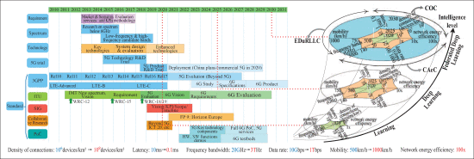
Introduction – Why 6G?
5G enables mobile internet, but has limits in speed, latency, and intelligence
6G is a leap from “connected things” to “connected intelligence”
Integrates AI natively in the network, enabling smarter, real-time services
Notes:
“Let’s start with the big picture — why do we even need 6G, when 5G isn’t fully rolled out yet?
While 5G has improved mobile speeds, reduced latency, and enabled new tech like AR and smart homes, it still has limitations. It can’t yet support a truly global, intelligent, and context-aware system.
That’s where 6G comes in. It aims to shift from just connecting devices to building a network of intelligence — where AI, data, and communication all merge.
This timeline helps show that we’ve moved from basic voice calls in 1G to mobile internet in 4G, and now, with 6G, we’re entering the era of connected intelligence — where learning, reasoning, and decision-making happen across the network.”

Slide 11
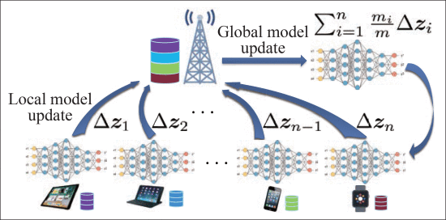
Key Features of 6G
Speed: Up to 1 Tbps
Latency: < 1 ms
Energy: Battery-free IoT support
Coverage: Satellite + terrestrial integration
AI-driven: Adaptive, context-aware networks
Notes:
“So what exactly does 6G bring to the table?
First — unimaginable speeds. We’re talking about up to 1 Terabit per second — that’s about 100x faster than 5G.
Second — ultra-low latency, under 1 millisecond. That’s faster than the human brain processes visual stimuli, which makes real-time feedback possible for things like remote robotic surgery or autonomous drones.
Third — energy efficiency. 6G networks will be able to support tiny IoT devices that can even operate without batteries, using energy harvested from the air.
And lastly — global coverage. By combining terrestrial networks with satellites and even drones, 6G will offer truly universal connectivity — no dead zones, not even in the ocean or mountains.”

Slide 12
6G vs 5G – What’s New?
Feature | 5G | 6G
Speed | ~10 Gbps | Upto 1Tbps
Latency | ~10 ms | <1 ms
Intelligence | Rule-based | AI-native learning
Network Scope | Urban Focused | Global(via satellites)
Services | eMBB, uRLLC, mMTC | + COC, CAeC, EDuRLLC
Notes:
“Let’s break down the differences between 5G and 6G.
With 5G, we got better speeds and the ability to connect more devices. But 6G goes far beyond that — it’s not just faster, it’s smarter.
6G integrates Artificial Intelligence right into the core of the network. That means the system can learn, adapt, and optimize itself — without human intervention.
It also supports more connected devices, has broader frequency bands, and is designed to handle computational tasks, not just data transmission.
Think of 6G as an AI-powered nervous system that senses the environment and adjusts itself constantly to serve users better.”

Slide 13
New Service Types in 6G
COC: Communication tailored for distributed computation
CAeC: Adapts to user, device, and environment context
EDuRLLC: Ultra-reliable low-latency in emergencies & dynamic conditions
Notes:
“6G introduces three new types of services that are impossible or inefficient to handle in 5G.
First — Computation-Oriented Communications, or COC. This supports edge and distributed computing. It ensures the network helps devices with heavy processing — for example, during federated learning, where your phone trains a model locally without sharing your private data.
Second — Contextually Agile eMBB. It adapts to your context — like your movement, surroundings, and even nearby devices — to offer the best speed and coverage based on what you’re doing.
And third — Event-Defined uRLLC. This provides ultra-reliable low-latency communication triggered by events. For example, in an emergency where a drone needs to take off instantly or cars need to brake automatically, the network responds in real time — prioritizing those actions above everything else.”

Slide 14
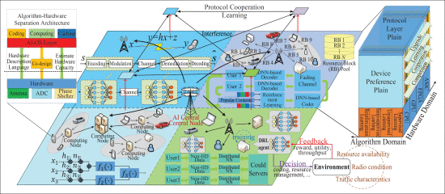
Architecture Overview
Network of Subnetworks: Localized, adaptable clusters
Intelligent Radio (IR): Learns from environment & hardware
Hardware-software separation: Enables modular upgrades
Notes:
“Now, let’s look at how 6G networks are built.
Unlike traditional networks, 6G will be a ‘network of subnetworks’. Each subnetwork — say, in a neighborhood, city block, or even inside a factory — can evolve independently. It learns from its users and upgrades without affecting the entire system.
A critical innovation here is the use of Intelligent Radio. Previous generations used fixed protocols — with software-defined radio (SDR) and cognitive radio (CR). But Intelligent Radio (IR) uses deep neural networks to adapt in real time.
The table here compares SDR, CR, and IR. IR not only understands the environment — it also senses the device’s hardware and adapts accordingly. That’s game-changing.”

Slide 15
Role of AI in 6G
Big Data Analytics: Real-time user & network insights
Closed-Loop Optimization: Self-tuning systems using AI
Intelligent PHY Layer: Learns encoding, decoding & adapts
Notes:
“Artificial Intelligence is the backbone of 6G.
First, it enables big data analytics — processing user data to predict behavior, optimize services, and manage traffic in real time.
Second, AI enables closed-loop optimization. That means the network monitors its own performance and keeps tuning itself automatically, much like a thermostat adjusts temperature.
Third, we have the Intelligent PHY layer — a physical communication layer where both the transmitter and receiver are trained together using machine learning.
This diagram shows federated learning, where many devices train AI models locally, then send updates to the server — keeping the raw data private while still building powerful global models.”

Slide 16
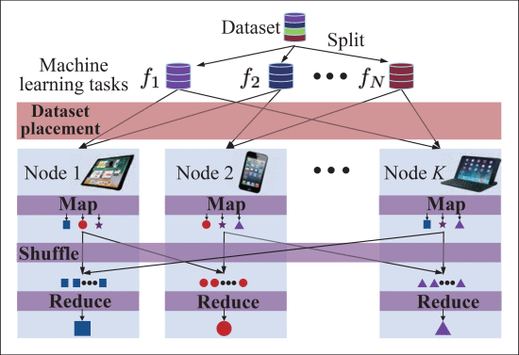
6G Applications
Edge AI: Processes data close to the source (e.g., phones, cars)
Smart Cities: Traffic, safety, utilities all connected
Autonomous Systems: Real-time, ultra-reliable communication
Notes:
“Let’s talk about where 6G will truly shine.
First — Edge AI. Instead of sending all data to the cloud, devices can process information locally and collaborate across the network.
In smart cities, 6G will power everything from traffic lights to pollution sensors to emergency response systems — all in real time.
For autonomous vehicles, the ultra-low latency will allow cars to make split-second decisions, avoid collisions, and communicate instantly with infrastructure.
The graphic here shows on-device distributed inference. 6G enables multiple edge devices to share and shuffle data intelligently — kind of like parallel computing, but wirelessly.”

Slide 17
Challenges and Innovations
Hardware cost & complexity: Need for simplified structures
Privacy & security risks: Must support encrypted, trusted data flows
Adaptive Networks: Must evolve with demand and technology
Notes:
“Of course, building 6G doesn’t come without challenges.
Hardware cost is one — especially at higher frequencies like millimeter and terahertz waves, where components get expensive and power-hungry.
Privacy and security are also concerns. With all this data moving through intelligent systems, we need stronger protection — especially for AI-driven decisions.
And then there’s the need for adaptive networks — systems that evolve as new devices and services are introduced.
A great innovation tackling hardware cost is shown here — a beamforming structure that uses fewer phase shifters but achieves similar performance. That’s exactly the kind of practical solution we’ll need in 6G.”

Slide 18
Conclusion and Future Outlook
6G is a paradigm shift toward intelligent, context-aware networks
Enables futuristic applications: autonomous systems, AI-driven cities
Will transform communication, computing, and society
Notes:
“To wrap up, 6G is more than just faster internet. It’s about building a living, intelligent infrastructure that adapts, learns, and improves everything from daily life to industry.
It will support AI-driven cities, real-time collaboration, autonomous machines, and even space-to-earth networks.
As this technology continues to develop, 6G will help us build a smarter, safer, and more connected future — one that empowers not just devices, but entire societies.
Thank you so much for listening! I’d be happy to take any questions.”

Slide 19
03
6G Wireless Networks: Vision, Requirements, Architecture, and Key Technologies
Based On Zhang et al., IEEE Vehicular Technology Magazine, 2019
Notes:
“Hi everyone! I’m Akashvarunn, and today I’m going to walk you through a super exciting topic — 6G wireless networks. This presentation is based on a paper published in IEEE Vehicular Technology Magazine in 2019 by Zhang and his team. We’ll go over what 6G is aiming to achieve, what makes it different from 5G, and the key technologies driving it. Let’s jump right in.”

Slide 20
Why Do We Need 6G?
5G cannot fully meet future application demands
Emerging use cases need ultra-high data rates and ultra-low latency
6G aims to support real-time sensing, large-scale automation, and AI-native services
Notes:
> “5G was revolutionary, no doubt — but our demands are skyrocketing. Think about applications like autonomous cars, smart factories, remote surgeries — they need extremely fast, low-latency, and reliable communication. 6G steps up to meet those demands. We're talking about handling real-time sensing, machine intelligence, and fully immersive virtual experiences. Basically, if 5G was a sprint, 6G is a space race.”

Slide 21
Vision & Use Cases
1 Tbps peak data rate, 10 μs latency, 10⁷ devices/km²
Ubiquitous full-dimensional coverage: space, air, ground, and underwater
Example use cases: immersive XR, holographic communication, industrial automation
Notes:
“The vision for 6G is insane — up to 1 terabit per second speeds and latency in microseconds. Even crazier? It’s going to support all environments: ground, air, space, and even underwater. Use cases? We’re talking real-time holographic meetings, ultra-immersive XR, automated industrial robotics, and seamless worldwide coverage. This isn’t sci-fi anymore — it’s already being researched.”

Slide 22
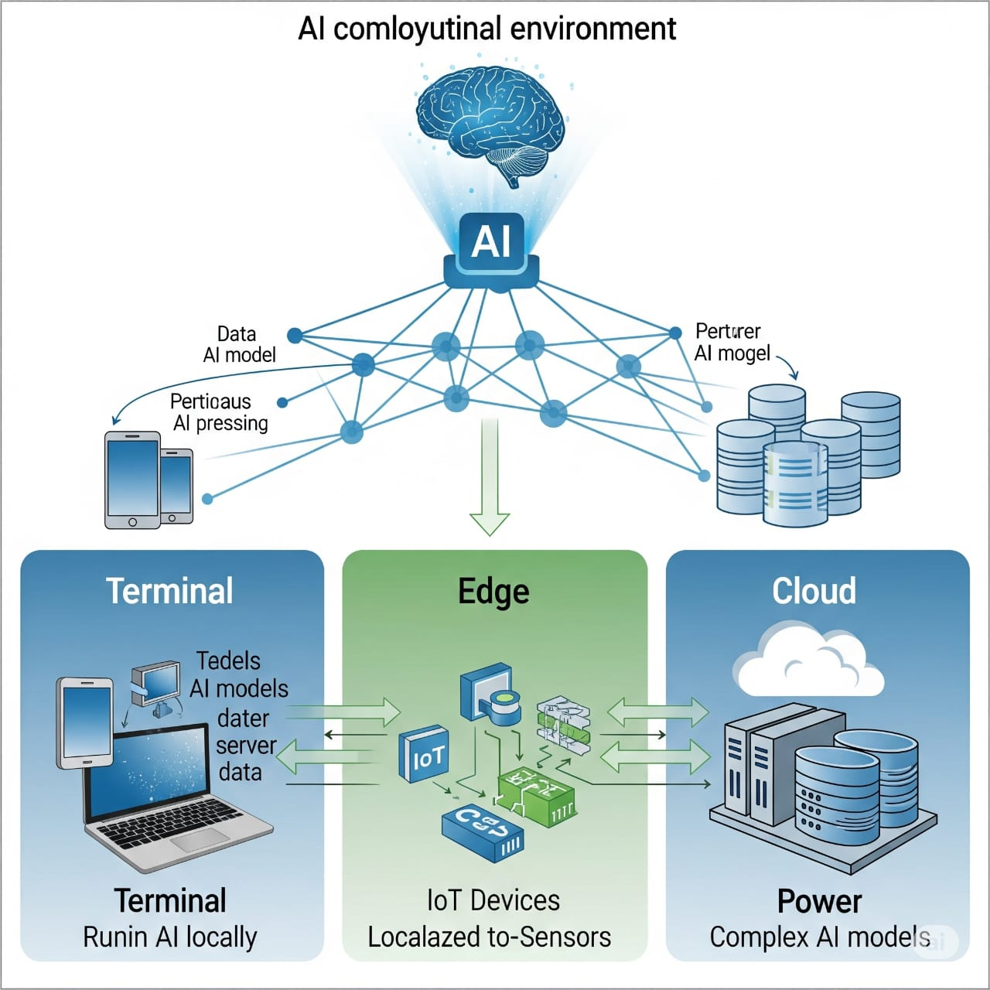
6G Requirements
Seamless global coverage with extreme reliability
High energy and spectral efficiency
Distributed AI with real-time decision-making capability
Integration of sensing, communication, and control functions
Notes:
> “For all of that to work, 6G has to hit some brutal benchmarks: ultra-low latency, energy efficiency, and global coverage. But more importantly, it needs to be smart — like actually intelligent. AI is built into the network to make it self-optimizing and self-healing. It also merges sensing, control, and communication into a single fabric. That’s wild compared to how 5G still separates those layers.”

Slide 23
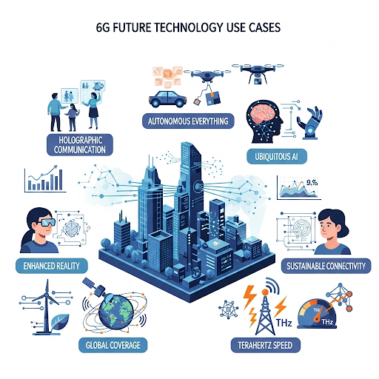
AI-Native Networking
AI embedded across terminal, edge, and cloud
Intelligent resource allocation, routing, and service management
Enables self-configuration, self-optimization, and self-healing networks
Notes:
> “Here’s what makes 6G totally different: it's AI-native. Not just AI-powered. It embeds intelligence at every layer — devices, edge servers, base stations, and the cloud. This AI makes decisions in real-time, like managing resources, traffic loads, handovers — even predicting failures before they happen. The result? Networks that don’t just react… they think and adapt.”

Slide 24
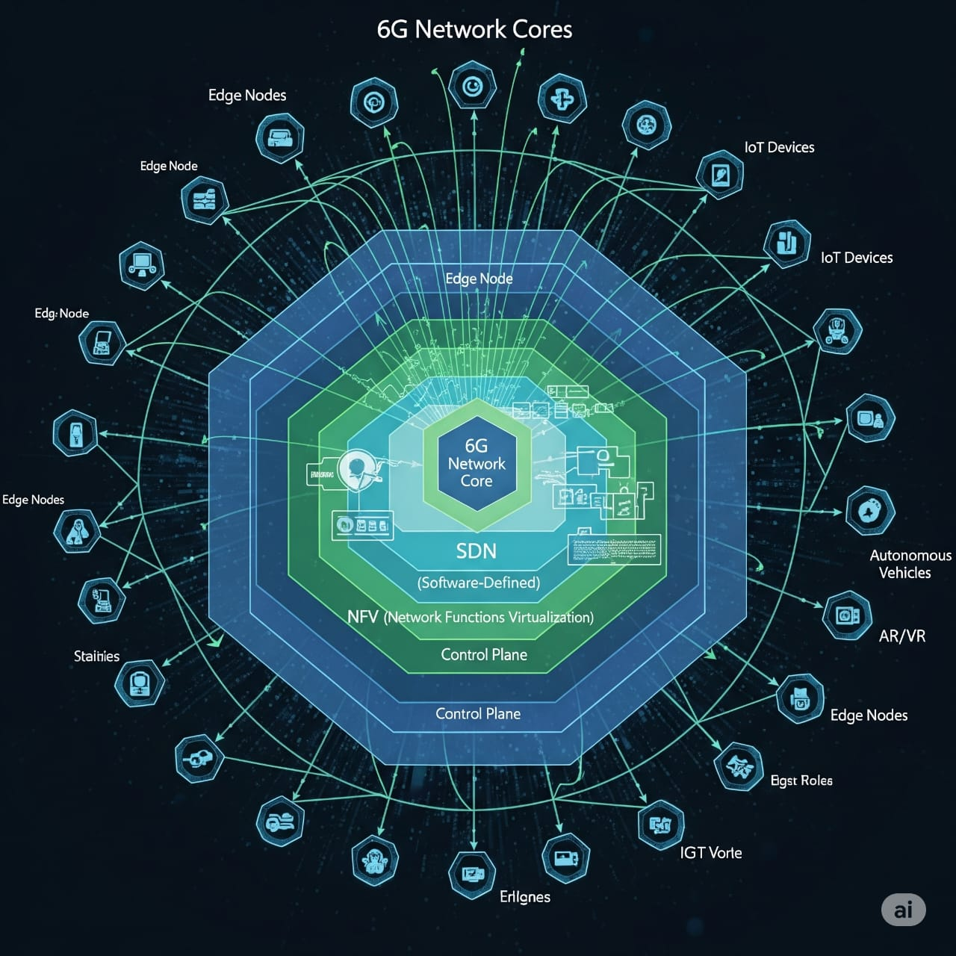
6G Architecture Overview
Four domains: space, aerial, ground, and underwater
Software-defined networking (SDN) and network function virtualization (NFV)
Network slicing to support heterogeneous services
Notes:
“This architecture is built like a layer cake — with coverage from satellites, drones, towers, and even underwater networks. All these layers work together using SDN and NFV — software-defined systems that can be reprogrammed on the fly. The network can be sliced to serve different services at once — like one slice for low-latency control, another for high-bandwidth XR. It’s modular, flexible, and scalable.”

Slide 25
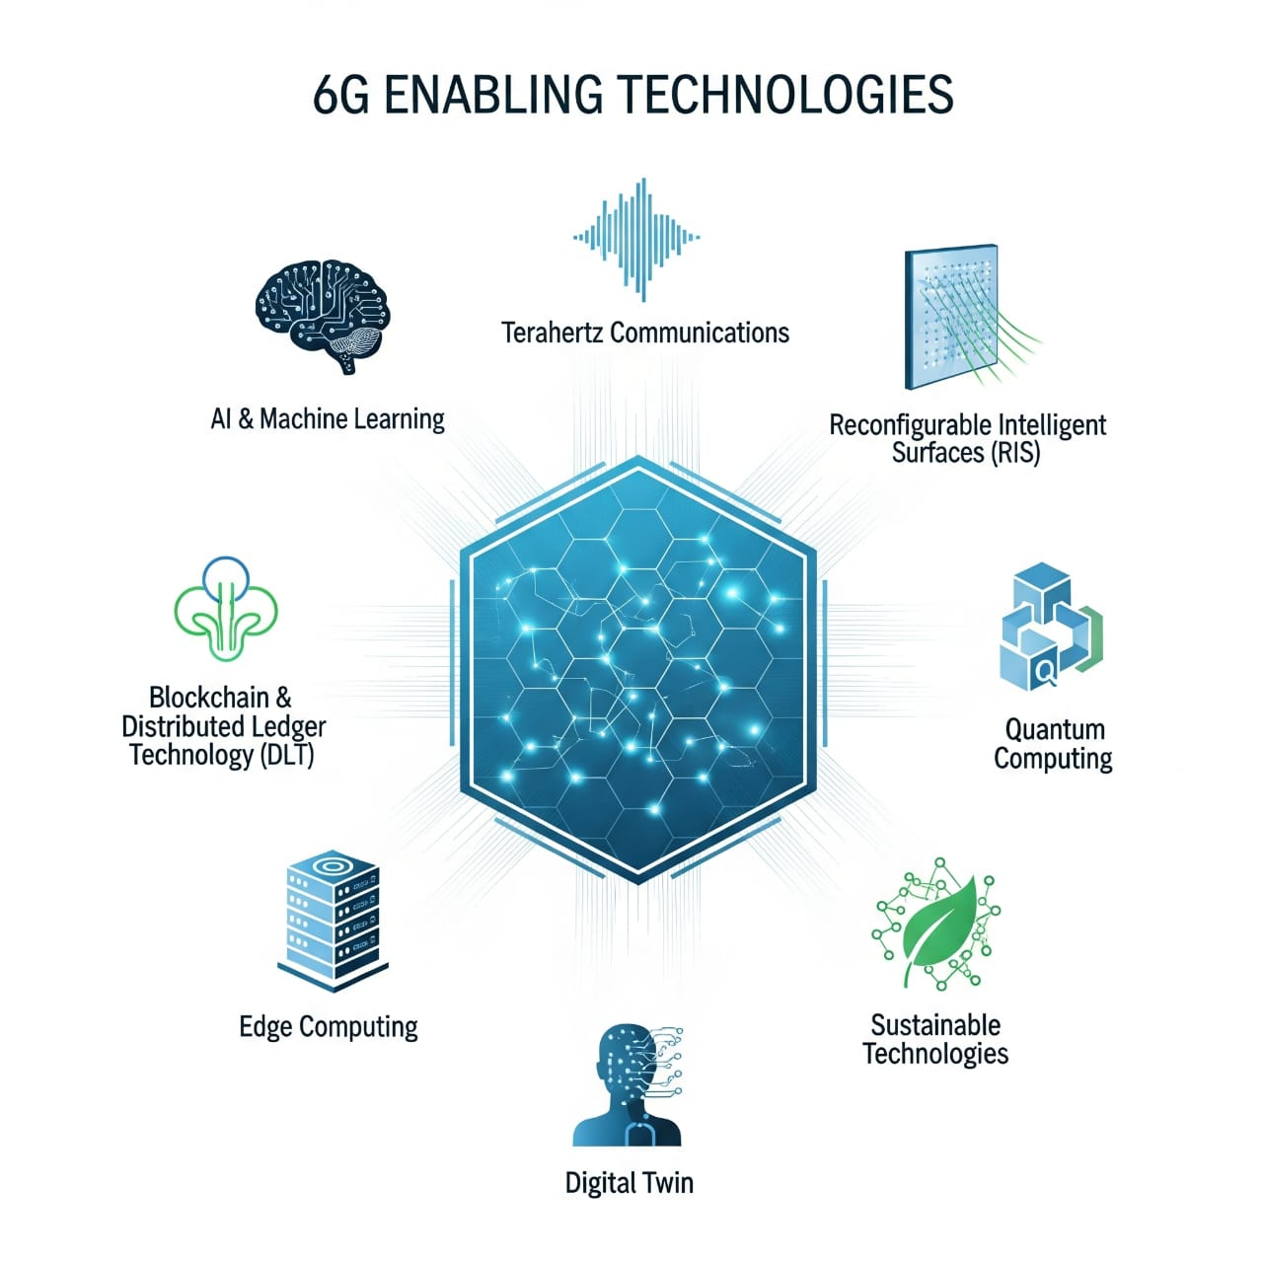
Key Enabling Technologies
Terahertz (THz) communication for high-speed links
Large Intelligent Surfaces (LIS) to control signal propagation
Visible Light Communication (VLC) and quantum communication
AI-driven algorithms like G-TSRA for intelligent task scheduling
Notes:
“The tech stack here is bleeding-edge. THz communications are the new frontier — ultra-high speed, but short range. Large Intelligent Surfaces help reflect and steer signals intelligently. We also have things like blockchain for secure spectrum sharing, visible light communication for tight indoor links, and AI-based scheduling algorithms to manage AI services themselves. Even quantum communication and nano-scale networking are being explored.”

Slide 26
Challenges and Research Directions
Scalability and generalization of AI models
Security, privacy, and explainability in AI-native networks
Energy-efficient architecture and real-time performance
Lack of global standards and real-world deployment issues
Notes:
“Sounds amazing, right? But — here’s the reality check. Big challenges still exist. We need AI models that are explainable, secure, and efficient enough to run on edge devices. Energy consumption is a huge concern. And the biggest? Standardization — every company and country has their own vision, and global alignment is still in progress. So there’s lots of research left to do.”

Slide 27
Conclusion
6G will be AI-native, ultra-fast, and hyper-connected
Aims to support new-generation services and applications
Still needs breakthroughs in hardware, AI, protocols, and architectures
Notes:
“To wrap up — 6G is a massive leap beyond 5G. It’s not just about speed — it’s about intelligence, ubiquity, and adaptability. The network will think, sense, decide, and serve — all in real-time. But to make that happen, we need advances across AI, hardware, wireless theory, and more. We're not there yet, but the roadmap is being built.”

Slide 28
04
6G Wireless Communications: Vision and Potential Techniques
Based On Ping Yang, Yue Xiao, Ming Xiao, and Shaoqian Li’s Research Paper

Slide 29
A New Framework: Innovating in Time, Frequency, and Space
The evolution of wireless boils down to one thing: how we use Time, Frequency, and Space.
Frequency: Moving beyond 5G's millimeter-wave into the Terahertz (THz) and even Visible-Light spectrums.
Space: Evolving from Massive MIMO to Ultra-Massive MIMO, with thousands of antennas to conquer signal loss.
Time: Compressing the basic time slot to be even faster, enabling the near-zero latency our future applications demand.
Notes:
"As we've heard, 6G is about more speed, more connections, and more intelligence. The Yang paper frames this entire evolution by looking at the three fundamental resources we have to work with: Time, Frequency, and Space. 6G pushes the boundaries of all three simultaneously.

Slide 30
The Four Pillars of 6G Technology
The Technical Foundations of 6G
Multi-band Ultrafast Transmission
Super Flexible Integrated Networks
Multi-mode, Multi-domain Joint Transmission
Intelligent Transmission (AI/ML)
Notes:
In the frequency domain, we're moving beyond 5G's millimeter-wave into the vast, unexplored territory of Terahertz waves. In the space domain, we're evolving from Massive MIMO with hundreds of antennas to Ultra-Massive MIMO, with potentially thousands of antennas to conquer signal loss at these new frequencies. And in the time domain, we're slicing moments into ever-finer pieces, compressing the basic time slot to be even faster to achieve that sub-millisecond latency our future applications demand."

Slide 31
A Deeper Dive into the Physical Layer
Smarter Ways to Send Data
Beyond just using more spectrum, 6G will use it more cleverly.
Multi-mode, Multi-domain Joint Transmission:
Orbital Angular Momentum (OAM): Using the physical shape of radio waves to carry more information, like twisting a signal into a corkscrew.
Index Modulation (IM): Encoding data not just in the signal itself, but in the indices of the resources used—like which antenna or which frequency is activated. It's like sending a message by who says it, not just what they say.
Notes:
"Building on this framework, the paper organizes the enabling technologies into four distinct pillars. We've already touched on the first two today: using multiple bands for speed and creating flexible, integrated networks.
But I want to draw your attention to the third pillar, which introduces some novel techniques at the physical layer. My colleagues discussed how AI will make the network smarter at a high level, but the Yang paper also highlights how we can build intelligence directly into the physical transmission of signals. This involves techniques like Orbital Angular Momentum, where we literally twist the radio waves into a corkscrew to pack in more data. Another fascinating concept is Index Modulation. Think of it this way: instead of just encoding information in the signal, we also encode information by choosing which antenna sends the signal. This creates a completely new dimension for data transmission, squeezing more efficiency out of every single resource."

Slide 32
The Road Ahead: Three Great Challenges
From Vision to Reality: The Hurdles We Must Overcome
The Power Supply Issue:
How do we power trillions of autonomous devices when our phone batteries barely last a day?
The Network Security Issue:
How do we secure a vast, decentralized network that spans from the ground, through the air, and into space?
The Hardware Design Issue:
How do we shrink large, lab-sized Terahertz components into a device that fits in your pocket?
Notes:
"And this brings me to the most critical part of my presentation, and a fitting conclusion for our team's overview. A vision is one thing, but execution is another. The Yang paper clearly identifies three monumental challenges that the entire 6G research community must solve.
First, power. It's a fundamental bottleneck. How do we power trillions of autonomous devices when our phone batteries barely last a day?
Second, security. Securing an incredibly complex, multi-layered network that spans from the ground, through the air, and into space is a challenge of a different order of magnitude.
And third, hardware. The physics of high-frequency communication requires components that are currently far too large and expensive for mass deployment. We have to shrink lab-sized equipment into a device that fits in your pocket."

Slide 33
Grand Conclusion: Synthesizing Our Findings
The Future of Connectivity
A Shared Vision: Across all our research, a clear picture emerges. 6G will be an AI-native, hyper-connected network fabric that integrates space, air, and ground systems.
The Path Forward: It will be built on new spectrums like Terahertz, new architectures like Cell-Free MIMO and Intelligent Surfaces, and new physical layer techniques like Index Modulation.
The Ultimate Test: The success of 6G will not be measured by theoretical speeds, but by our ability to solve the practical, fundamental challenges of Power, Security, and Hardware.
Notes:
"So, to conclude for our entire team today: across all four papers we've presented, a consistent vision for 6G emerges. It's a network that is intelligent to its core, a hyper-connected fabric that seamlessly integrates space, air, and ground systems.
The path forward will be built on new spectrums like Terahertz, new architectures like Cell-Free MIMO and Intelligent Surfaces, and new physical layer techniques like the ones we just discussed.
However, as we've just seen, the path forward is not guaranteed. The ultimate success of 6G will not be measured by theoretical speeds, but by our ability to solve the practical, fundamental challenges of Power, Security, and Hardware. This is where the most critical work remains to be done."

Slide 34
Thank You

